Slide 1
1. Need to update the logo (size back to how it was and better quality version – pixelated at moment)
2. Need to update the position of the logo and headers very slightly (my fault for not being more specific)
3. Grey line underneath the header bar needs to be darker to clearly mark out space
4. Header still very ‘jumpy’ when you scroll down the page – feels buggy (quite important)
5. Social handles still turning red when you scroll over the top of them
6. The computer image underneath About Us still isn’t transitioning in correctly (they fade in rather than popping up from underneath)
7. Text on About Us seems too narrow. Could do with certain lines being made wider and there being spaces in between certain lines to show they are new paragraphs.
8. Need to update the icon on the right from the mail icon to conversation icon
9. Couple of minor updates further down page

Slide 2
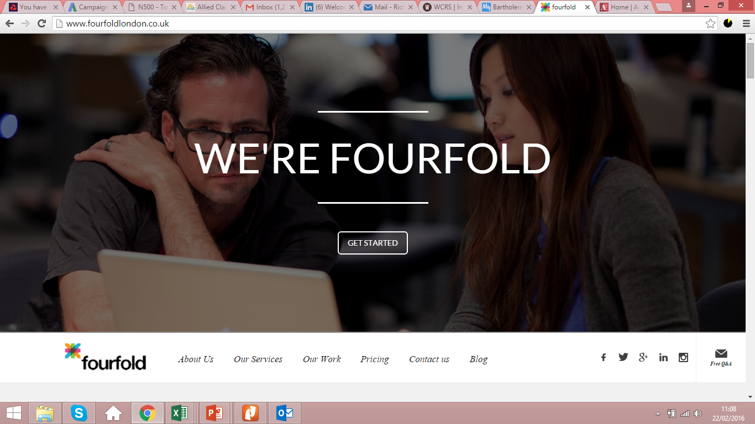
This is what it looks
like now

Slide 3


This is where the logo and headings should be I think

Slide 4
The header is still really ‘jumpy’ when I scroll down the page

Slide 5


Correct logo – pic part of logo touching
‘f’ on fourfold (have sent you)
Convo icon instead of mail icon (have sent you)
Also, notice the grey line at the bottom of the header on slide 3…

Slide 6
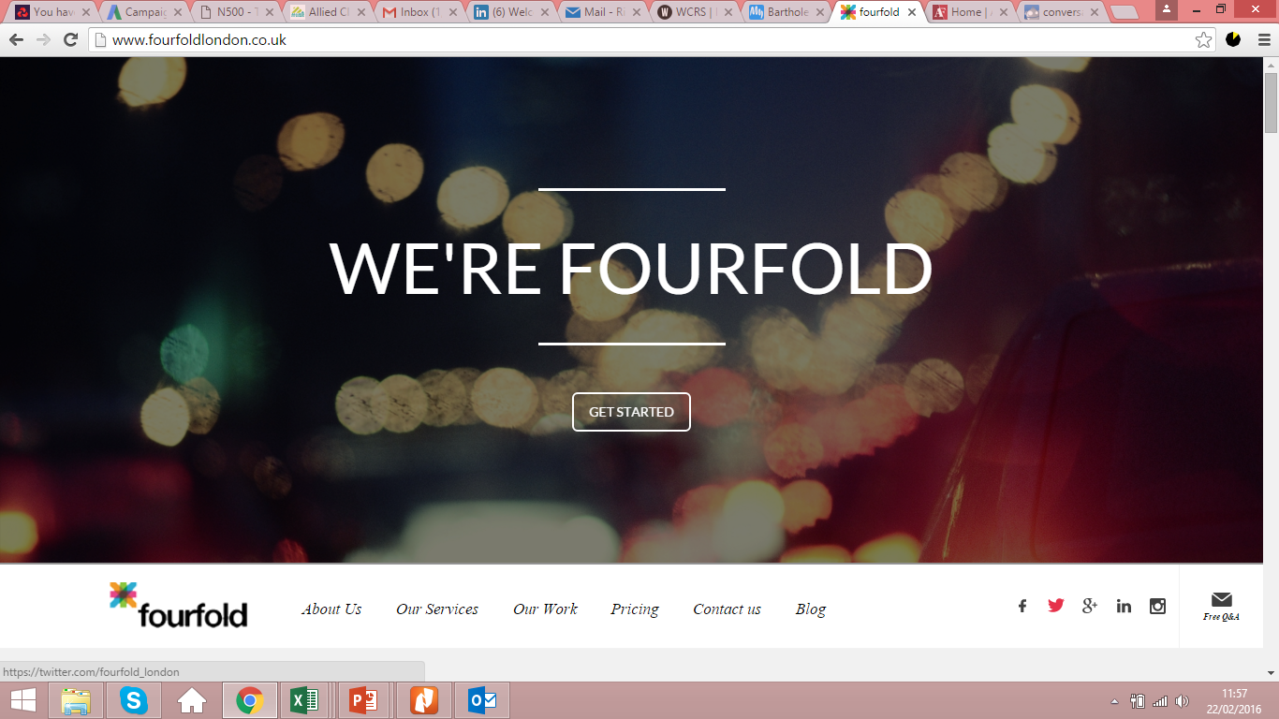
These are still red when you scroll over the top of them

Slide 7
About Us copy does look a little narrow looking at it again. Would be good to get it like the mock up I sent you if possible (except without the top line being in bold)

Slide 8
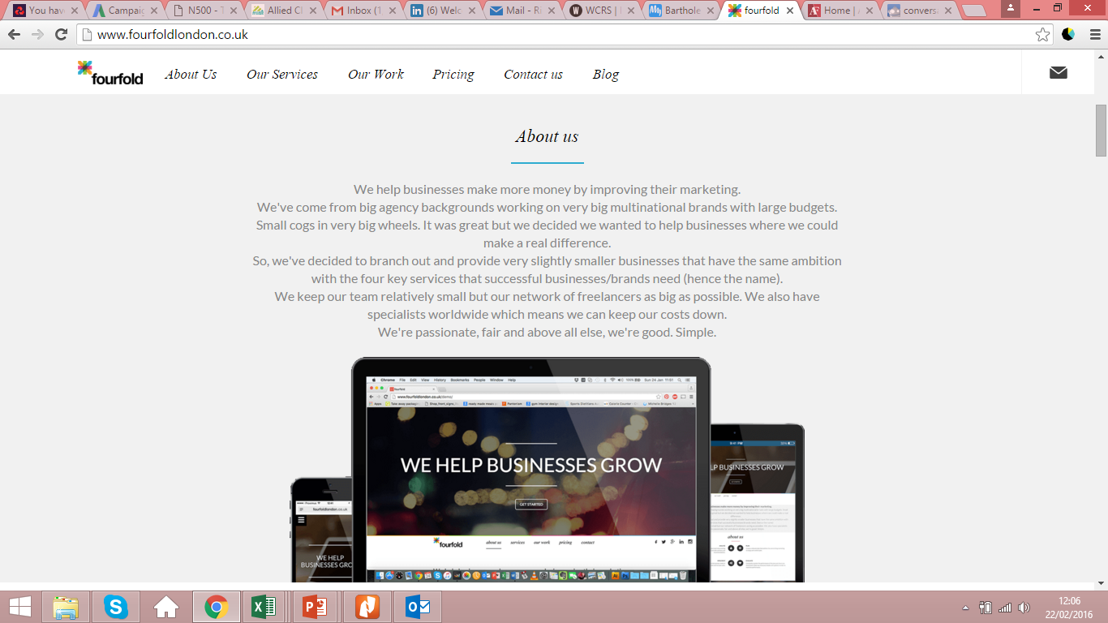
“their marketing and sales.”
Try and make it the same as next slide if possible

Slide 9
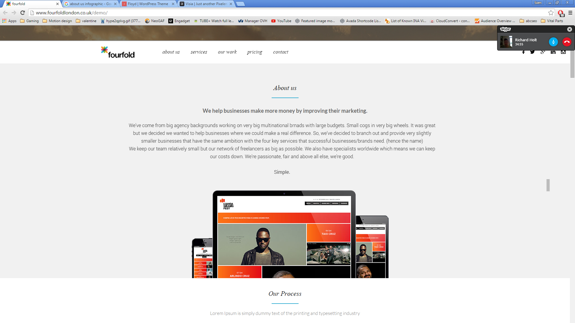
Ignore the computer image (the one we’re using is great)
But if we could make the copy match the above it would be great (except no bold line at the top)
“Simple” can be on the same line as sentence before – like you have it

Slide 10
Once you scroll down (once the logo has been updated with the correct one) it’s great
But I don’t want the headers turning bold when you scroll through the sections. Having the lines underneath is enough
If the headers on mobile are bold (I think they are) – are you able to take that off please as well (I thought they didn’t look quite right but couldn’t work out what that was)

Slide 11
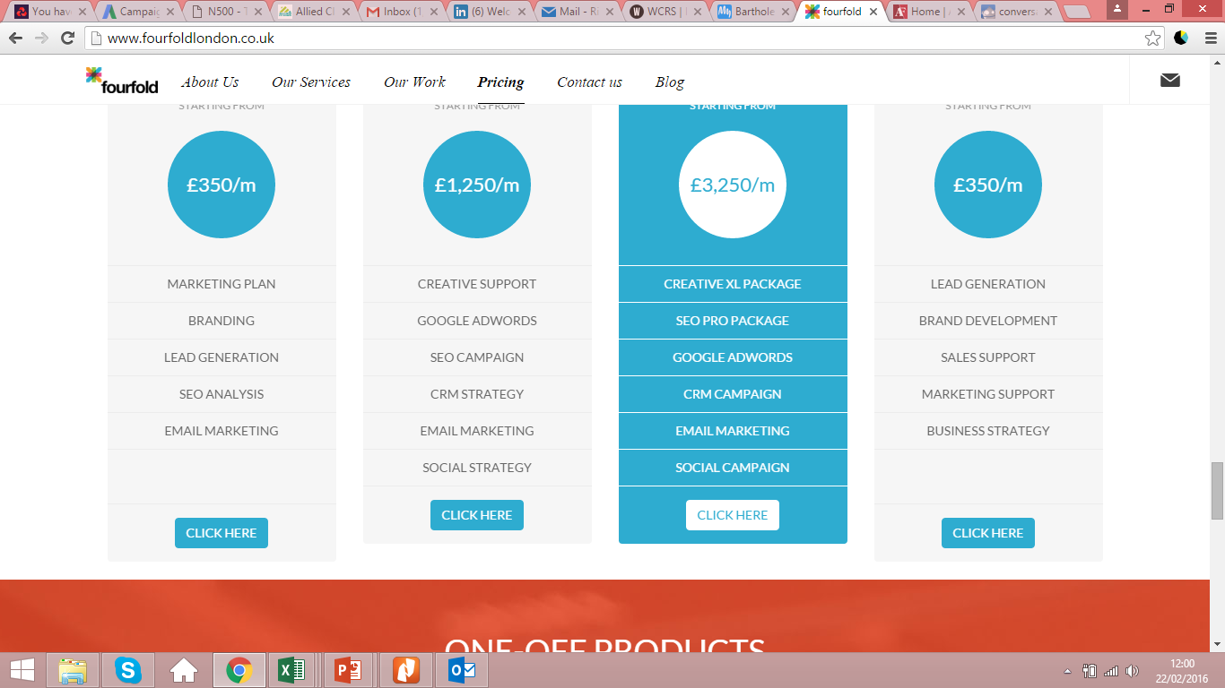
These are out of line now

Slide 12
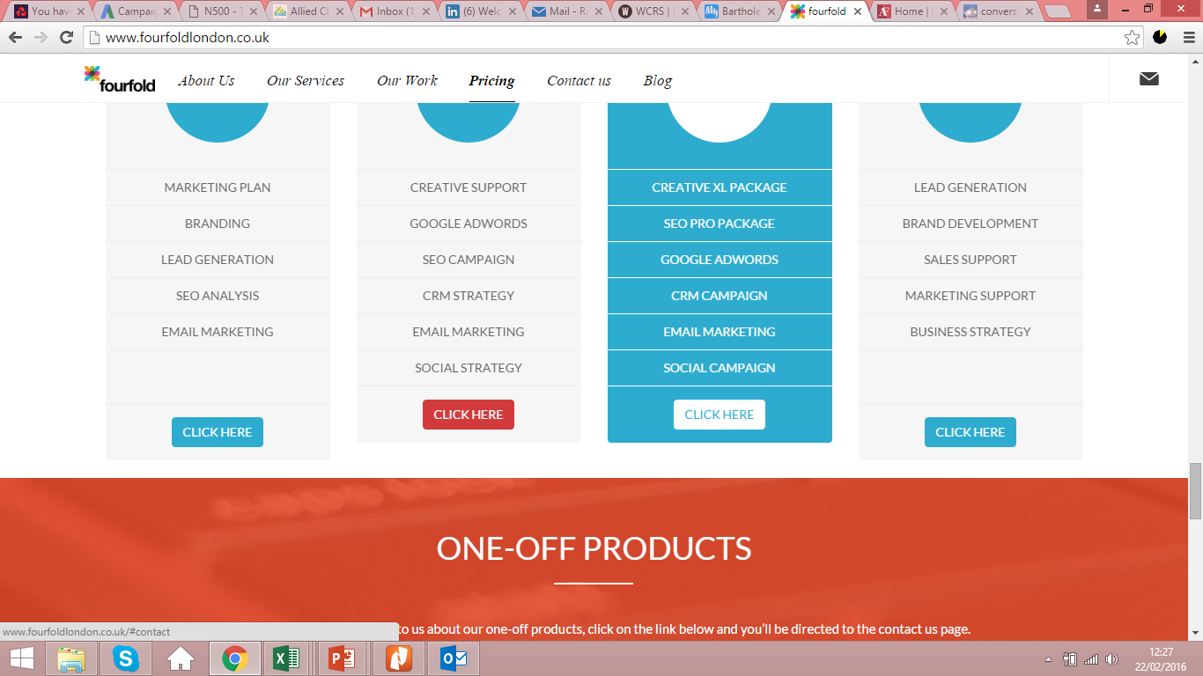
Button turning red when you scroll over the top

Slide 13
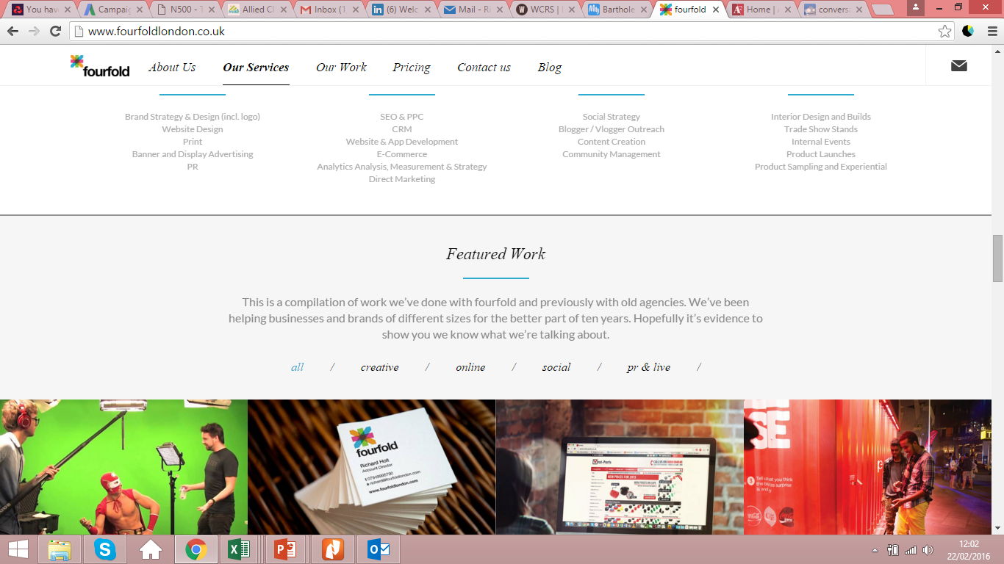
Don’t need the last forward slash

Slide 14
Everything else looks great!

